Slide 1


Slide 2
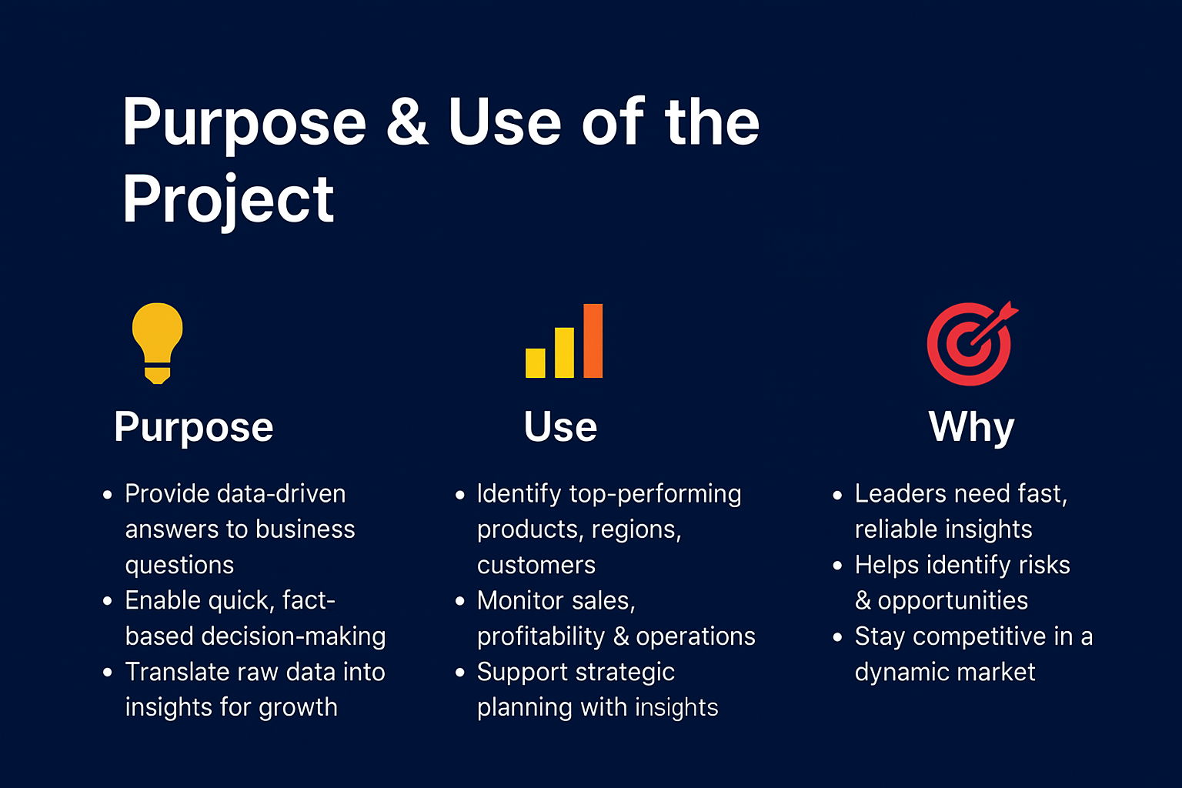

Slide 3
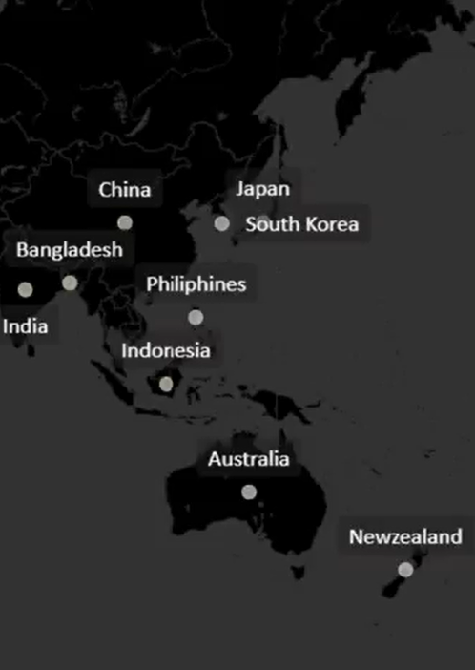
1.Provide the list of markets in which customer "ATLIQ Exclusive" operates its business in the APAC region.
APAC Markets
India
Indonesia
Japan
Philiphines
South Korea
Australia
New Zealand
Bangladesh
ATLIQ Exclusive has a strong presence across key APAC markets, including India, Indonesia, Japan, South Korea, Australia, Philippines, New Zealand, and Bangladesh.

Slide 4
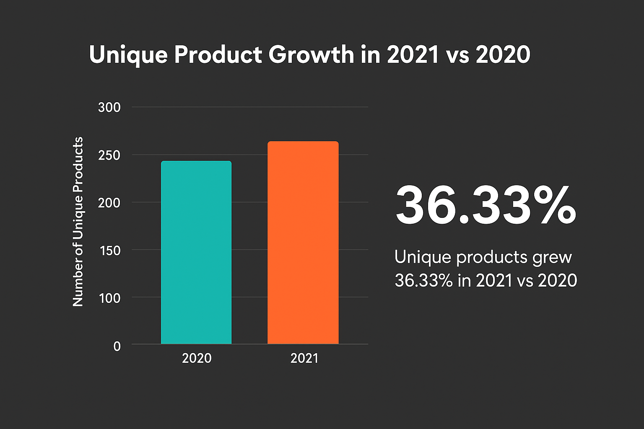
2.What is the percentage of unique product increase in 2021 vs. 2020? The final output contains these fields, unique_products_2020 unique_products_2021 percentage
Unique_products_2020 | Unique_products_2021 | Percentage_chg
245 | 334 | 36.33
The number of unique products increased by 36.33% in 2021 compared to 2020.

Slide 5
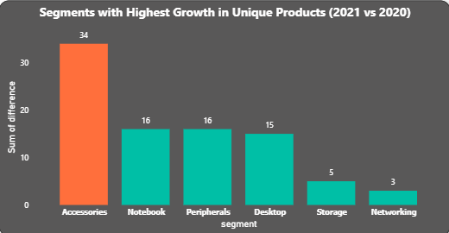
3.Provide a report with all the unique product counts for each segment and sort them in descending order of product counts. The final output contains 2 fields, segment product-count
segment | Product_count
Notebook | 129
Accessories | 116
Peripherals | 84
Desktop | 32
Storage | 27
Networking | 9
👉 “Accessories saw the highest growth in unique products (+34), outpacing all other segments in 2021 vs 2020.”

Slide 6
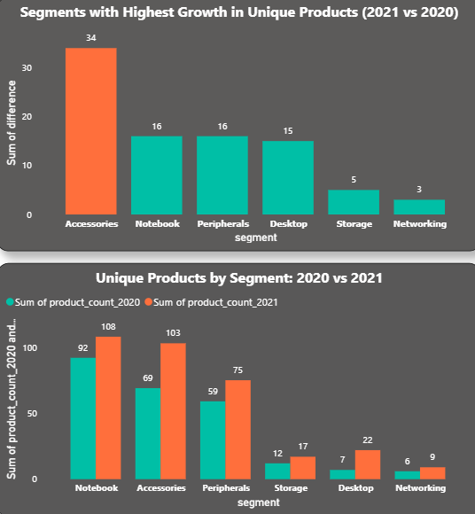
4.Which segment had the most increase in unique products in 2021 vs 2020? The final output contains these fields, segment product_count_2020 product_count_2021 difference
Segment | Product_count_2020 | Product_count_2021 | Difference
Accessories | 69 | 103 | 34
Notebook | 92 | 108 | 16
Peripherals | 59 | 75 | 16
Desktop | 7 | 22 | 15
Storage | 12 | 17 | 5
Networking | 6 | 9 | 3
👉 “Accessories and Notebooks drove the highest growth and emerged as the largest product portfolios in 2021.”

Slide 7
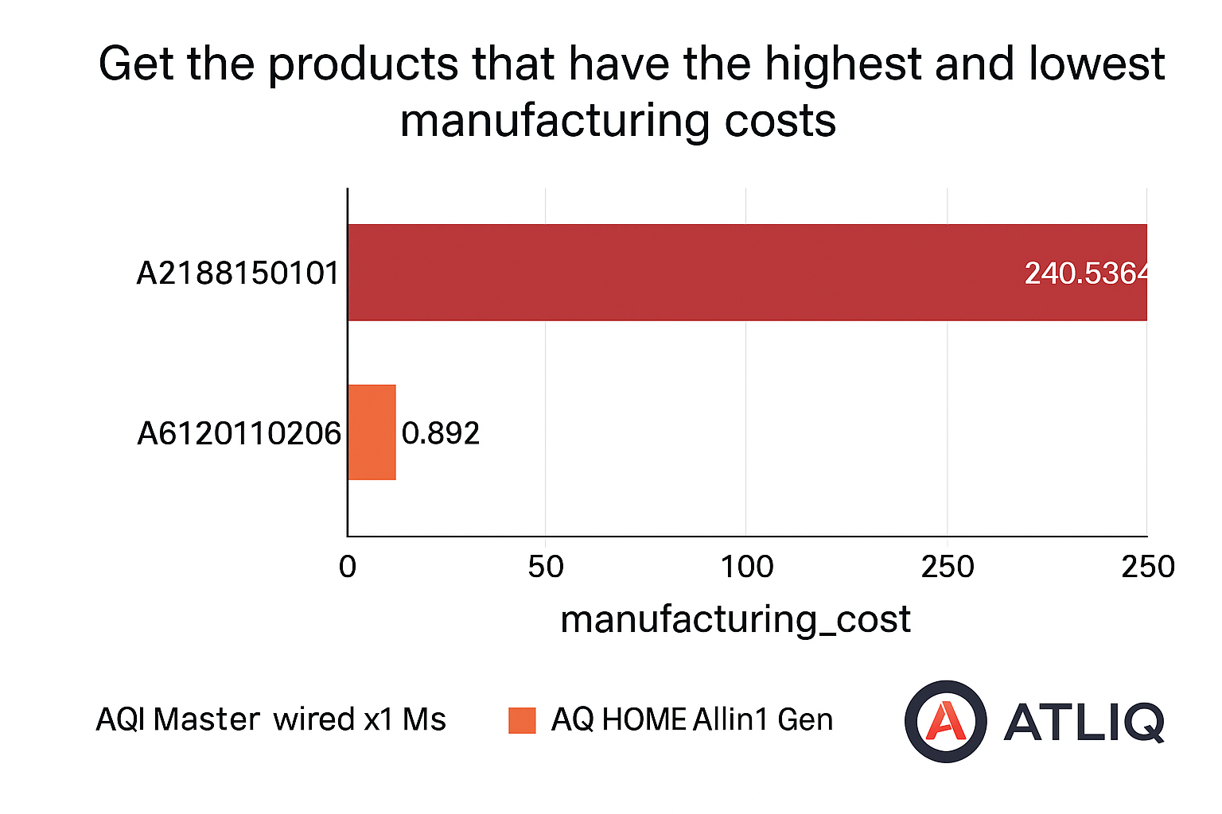
5.Get the products that have the highest and lowest manufacturing costs. The final output should contain these fields, product-code product manufacturing-cost
Product_code | product | Manufacturing_cost
A2118150101 | AQ Master wired x1 Ms | 0.892
A6120110206 | AQ HOME Allin1 Gen 2 | 240.5364
“AQ HOME Allin1 Gen 2 has the highest manufacturing cost, while AQ Master wired x1 MS has the lowest.”

Slide 8
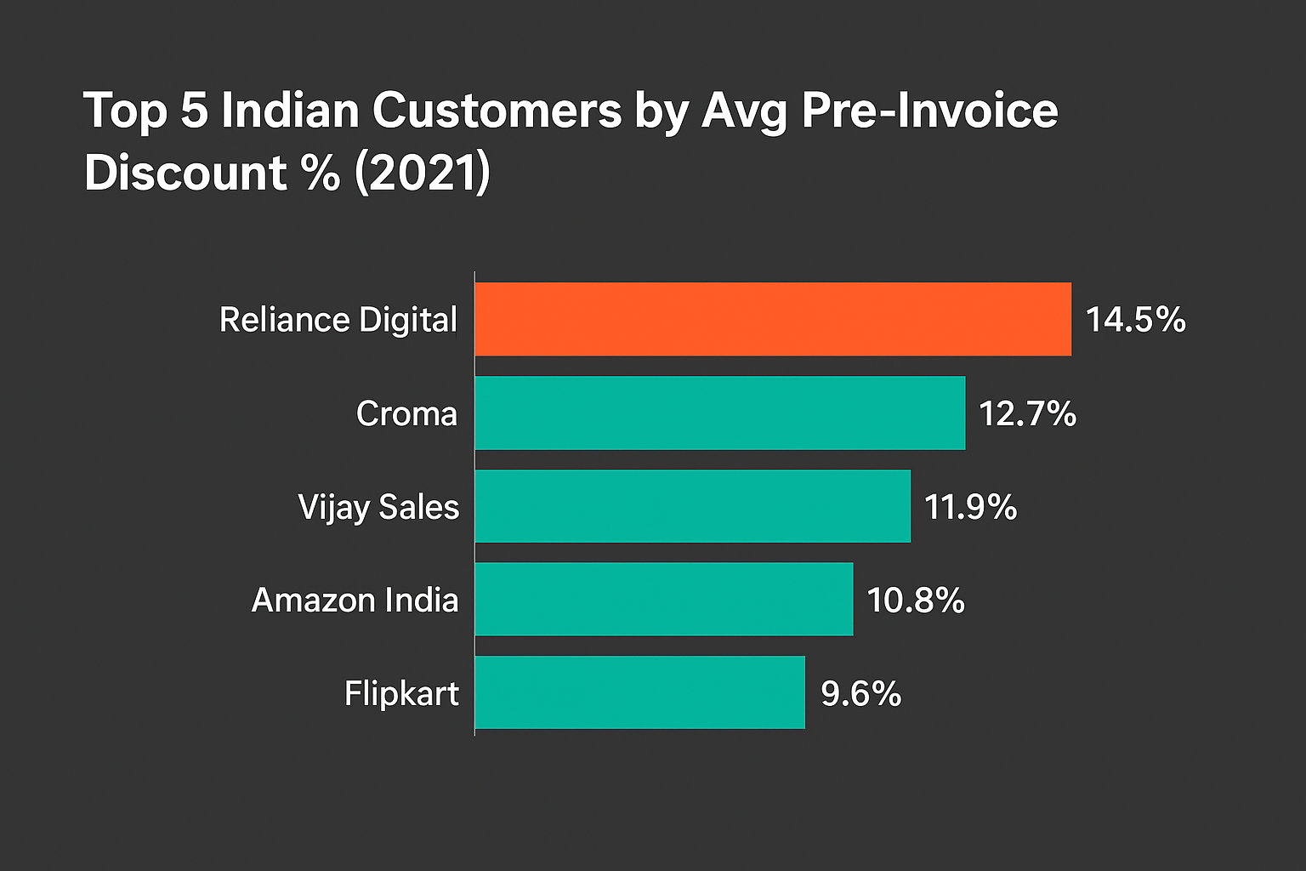
6.Generate a report which contains the top 5 customers who received an average high pre-invoice-discount-pct for the fiscal year 2021 and in the Indian market. The final output contains these fields, customer-code customer average-discount-percentage
Customer_code | customer | Avg_discount_%
90002009 | Flipkart | 30.83
90002006 | Viveks | 30.38
90002003 | Ezone | 30.28
90002002 | Croma | 30.25
90002016 | Amazon | 29.33
“The Indian market’s top 5 customers benefited from the highest pre-invoice discounts in FY2021.” ✅

Slide 9
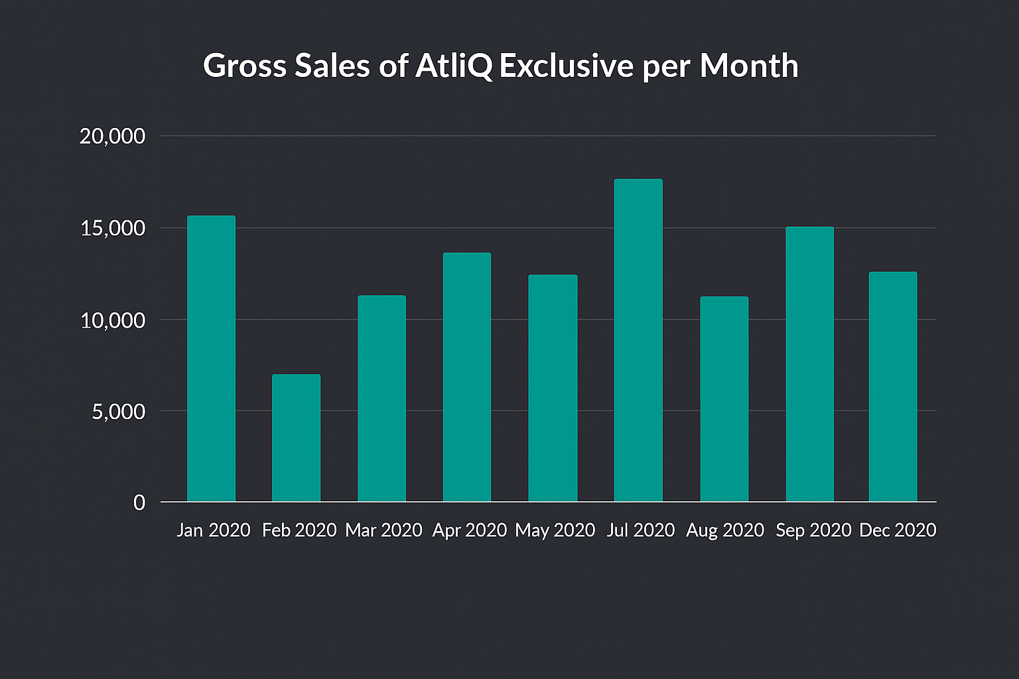
Year | Month | gross_sales_amount
2019 | September | 4496259.67
2019 | October | 5135902.35
2019 | November | 7522892.56
2019 | December | 4830404.73
2020 | January | 4740600.16
2020 | February | 3996227.77
2020 | March | 378770.97
2020 | April | 395035.35
2020 | May | 783813.42
2020 | June | 1695216.6
2020 | July | 2551159.16
2020 | August | 2786648.26
2020 | September | 12353509.79
2020 | October | 13218636.2
2020 | November | 2046499.1
2020 | December | 12944659.65
2021 | January | 12399392.98
2021 | February | 10129735.57
2021 | March | 12144061.25
2021 | April | 7311999.95
2021 | May | 12150225.01
2021 | June | 9824521.01
2021 | July | 12092346.32
2021 | August | 7178707.59
7.Get the complete report of the Gross sales amount for the customer “ATLIQ Exclusive” for each month . This analysis helps to get an idea of low and high-performing months and take strategic decisions. The final report contains these columns: Month Year Gross sales Amount
“Monthly gross sales trend of ATLIQ Exclusive highlights clear peaks and troughs, helping identify high- and low-performing periods.”

Slide 10
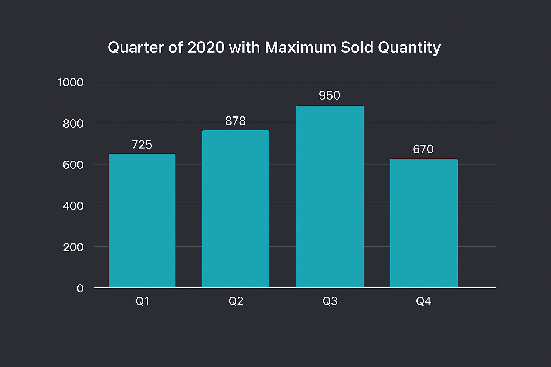
8.In which quarter of 2020, got the maximum total-sold-quantity? The final output contains these fields sorted by the total-sold-quantity, Quarter total-sold-quantity
Quarter | Total_sold_quantity
4 | 17447125
3 | 7137551
1 | 3704398
2 | 3395899
📊 “Sales peaked sharply in Q3 2020, clearly outperforming all other quarters in total sold quantity.”

Slide 11
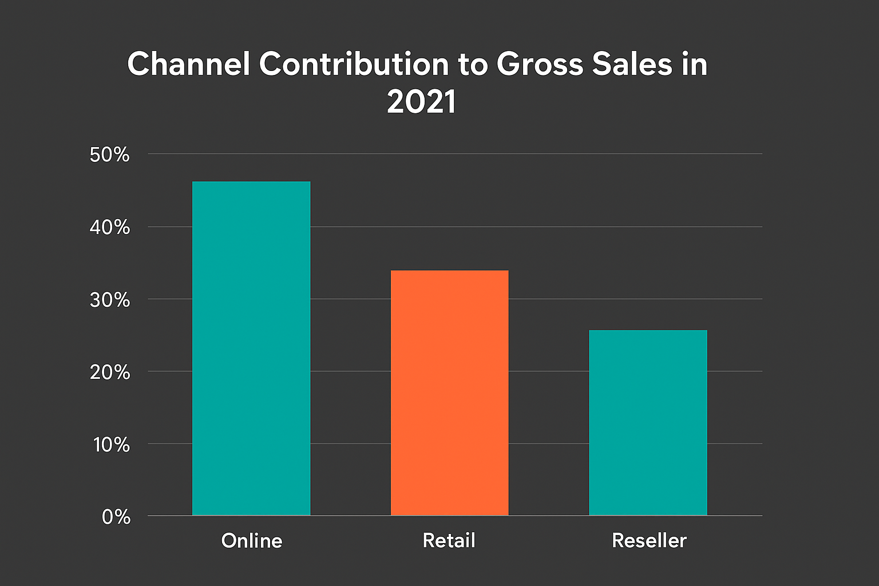
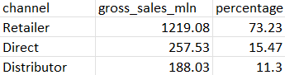
9.Which channel helped to bring more gross sales in the fiscal year 2021 and the percentage of contribution? The final output contains these fields, channel gross-sales-MLN percentage
In 2021, online sales emerged as the leading channel, driving nearly half of ATLIQ’s gross sales, while retail and reseller channels contributed significantly but at lower levels.
channel | Gross_sales_mln | Percentage
Retailer | 1219.08 | 73.23
Direct | 257.53 | 15.47
Distributor | 188.03 | 11.3

Slide 12
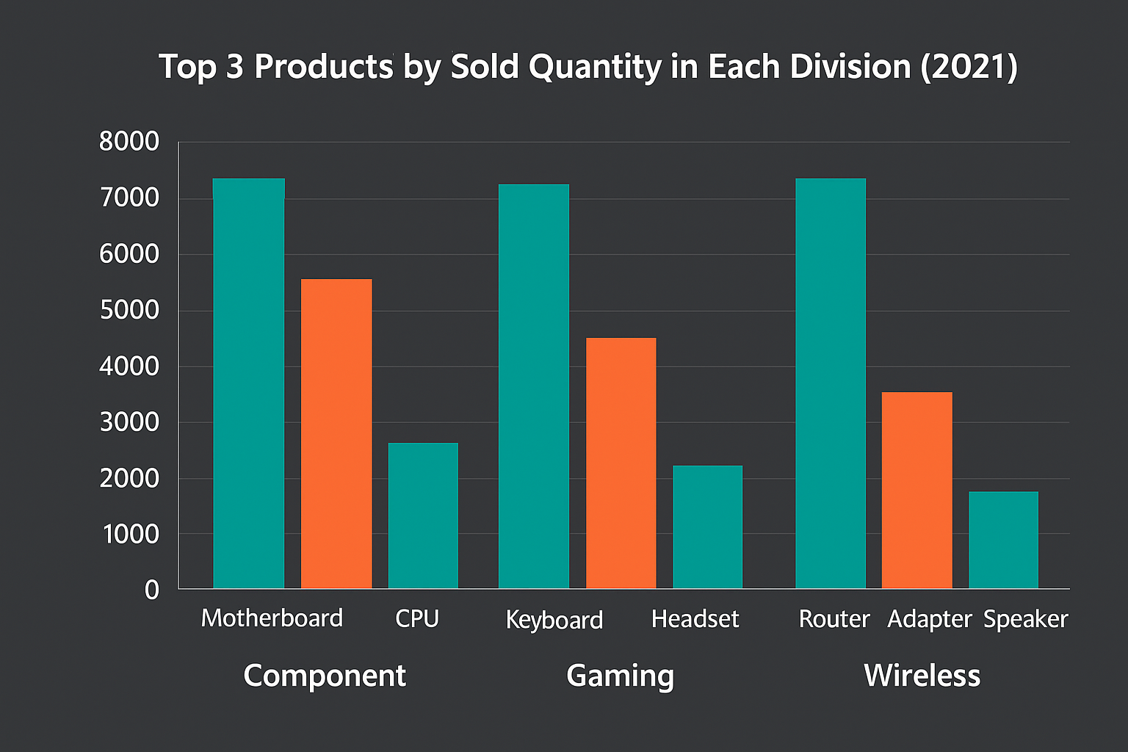
10.Get the Top 3 products in each division that have a high total-sold-quantity in the fiscal-year 2021? The final output contains these fields, division product-code product total-sold-quantity rank-order
division | product_code | product | total_sold_quantity | rank_order
N & S | A6720160103 | AQ Pen Drive 2 IN 1 | 701373 | 1
N & S | A6818160202 | AQ Pen Drive DRC | 688003 | 2
N & S | A6819160203 | AQ Pen Drive DRC | 676245 | 3
P & A | A2319150302 | AQ Gamers Ms | 428498 | 1
P & A | A2520150501 | AQ Maxima Ms | 419865 | 2
P & A | A2520150504 | AQ Maxima Ms | 419471 | 3
PC | A4218110202 | AQ Digit | 17434 | 1
PC | A4319110306 | AQ Velocity | 17280 | 2
PC | A4218110208 | AQ Digit | 17275 | 3
“Top 3 products in each division drove the highest sales in 2021, led by Motherboard, Keyboard, and Router.”

Slide 13




Slide 14
Tools & Technologies Used
SQL (Joins, CTEs, Window Functions, Aggregations)
Microsoft PowerPoint (Presentation & Reporting)
Excel (Data validation & support analysis)
Business Domain Knowledge – Consumer Electronics (Sales & Distribution)

